Slide 1
Student learning, collaboration and community engagement
Learning and Innovation Forum
Northern Sydney Institute
St Leonards Campus
2014
Jenny Shanley
Notes:
My presentation will reflect on 3 of my own projects that incorporate student learning and collaboration, and community engagement. I will focus on delivery and assessment, student experience, community responses, and working within the organisational requirements of TAFENSW.

Slide 2



A student assessment:
Class pitch to Hornsby Shire Council
Facilitator + creative director
An e-learning program:
NSI project with Warringah Council
Program developmer + instructional designer
An innovative learning space:
Hornsby campus simulated workplace
Studio manager + team co-ordinator
3 projects
Notes:
A student assessment, an e-learning program, and an innovative learning space.
A student assessment:
Class pitch to Hornsby Shire Council
Facilitator and creative director
An e-learning program:
NSI project with Warringah Council
Program development and instructional design
An innovative learning space:
Hornsby campus simulated workplace
Studio manager and team co-ordinator

Slide 3
themes in my practice:
sustainability
colours
learning
collaboration
community
creativity
design
systems
usability
action learning
society
industry
reflection
marketing
branding
meaning
Notes:
sustainability
colours
learning
collaboration
community
creativity
design
systems
usability
action learning
society
industry
reflection
marketing
branding
meaning

Slide 4
Purpose:
to develop a collaborative approach to delivery
and assessment;
to engage with a local organisation;
to produce meaningful work;
to promote sustainability;
to utilise available resources for social benefit.
Notes:
Purpose
to develop a collaborative approach to delivery and assessment;
to engage with a local organisation;
to produce meaningful work;
to promote sustainability;
to utilise available resources for social benefit

Slide 5
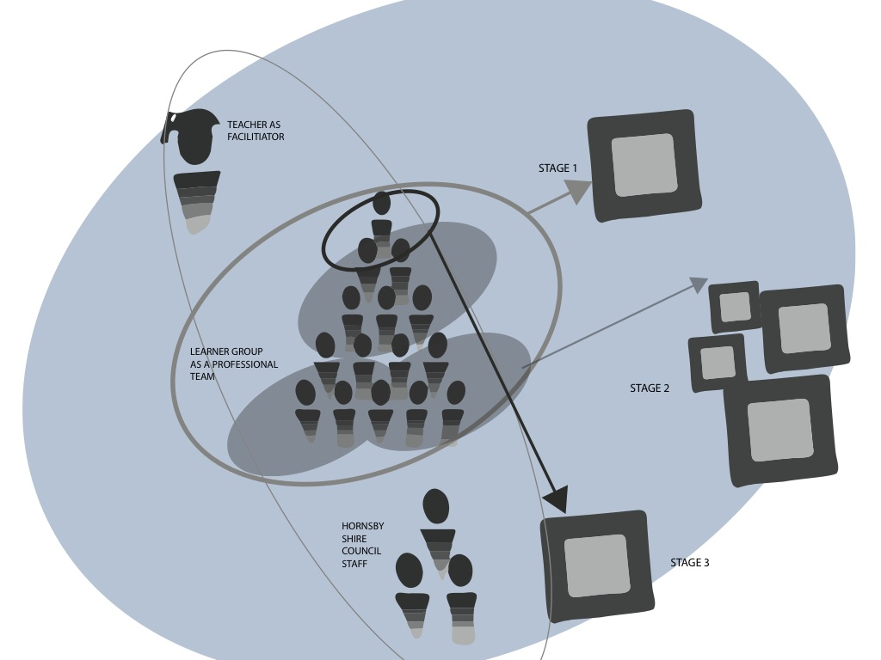
Notes:
The collaborative classroom

Slide 6


Slide 7

Notes:
Here’s what the project looked like at presentation

Slide 8
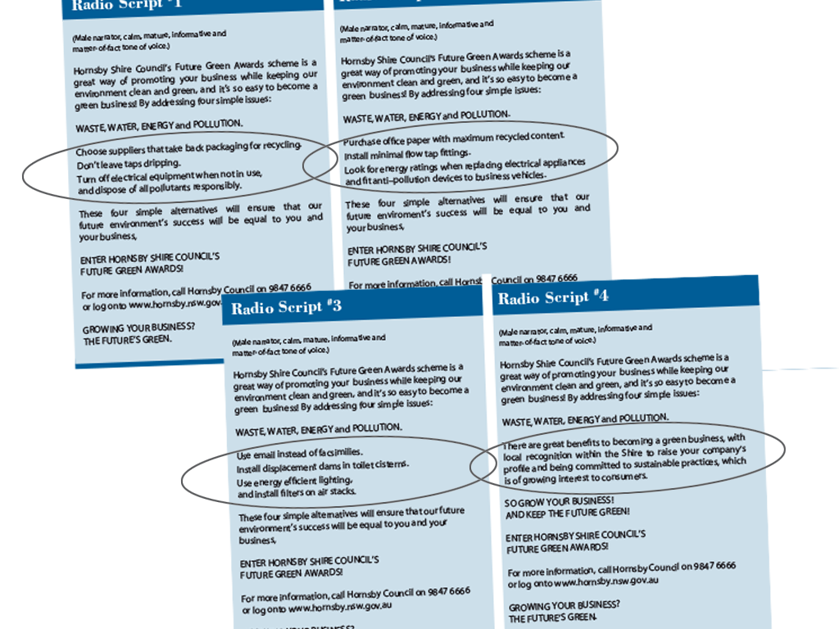
Notes:
Students had to research their subject

Slide 9
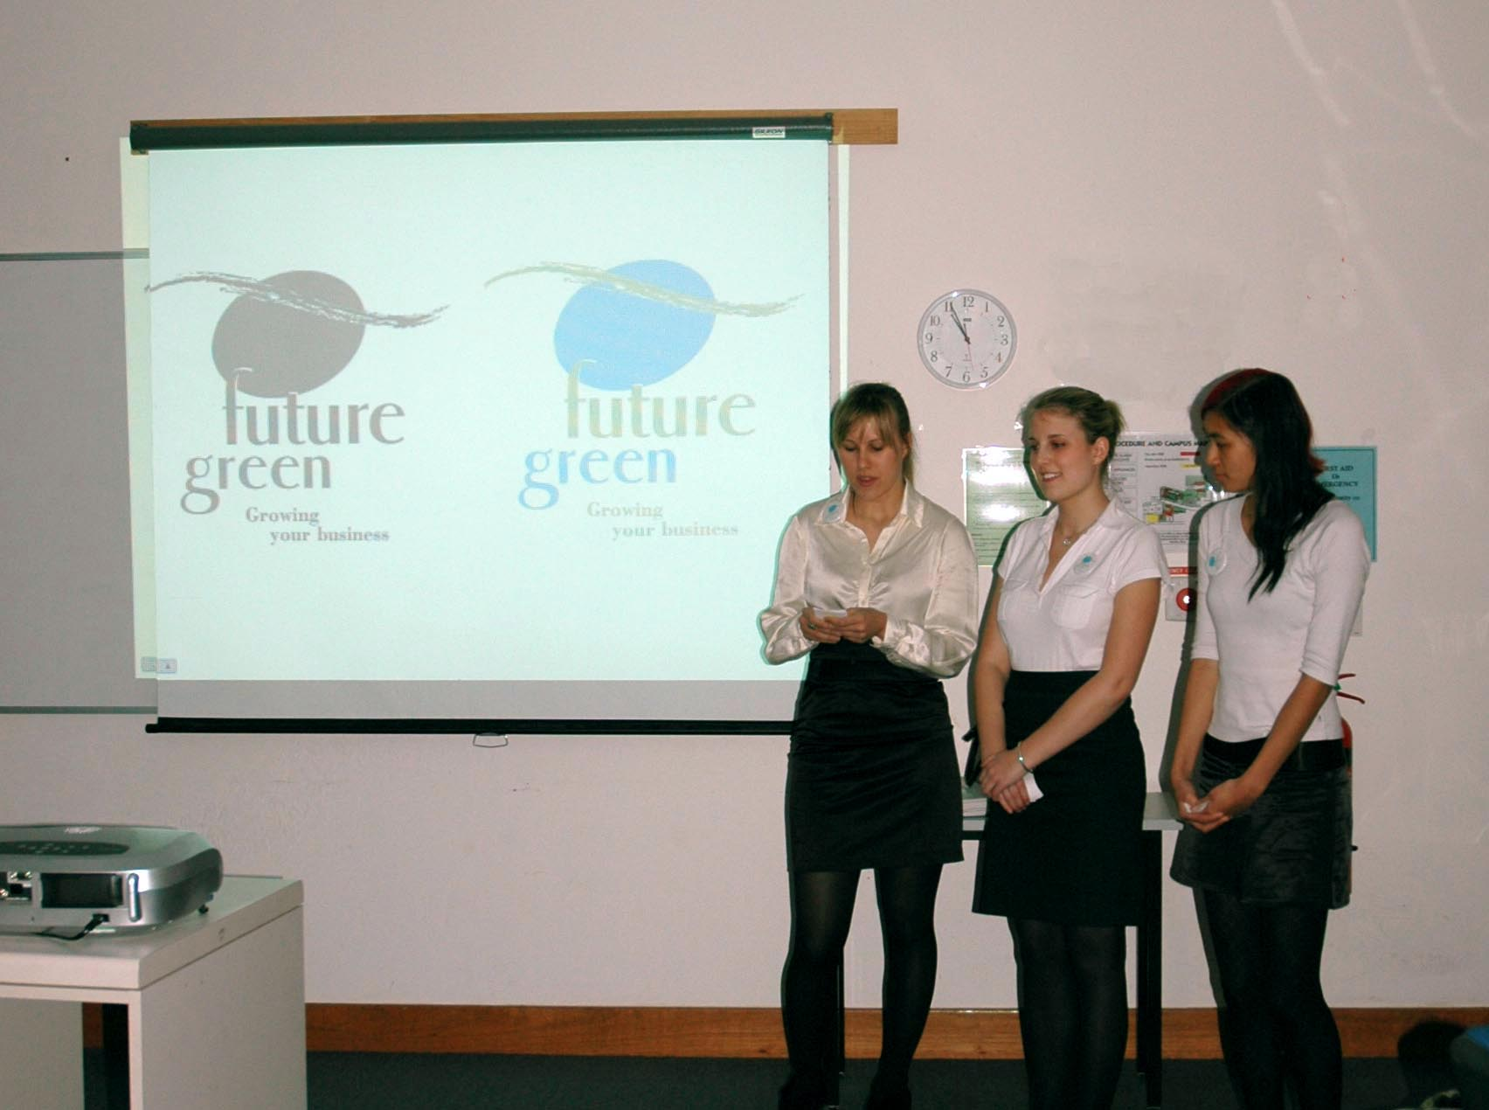
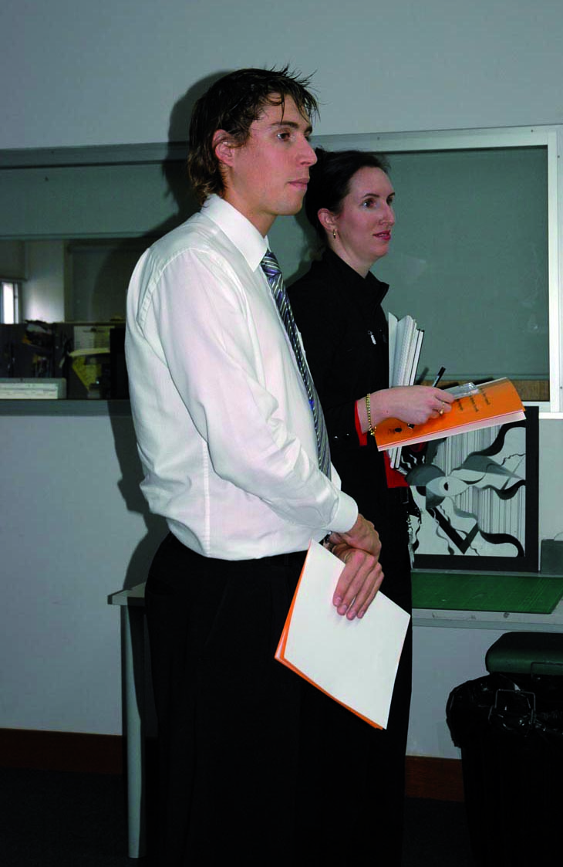
Notes:
Pitching to HSC

Slide 10
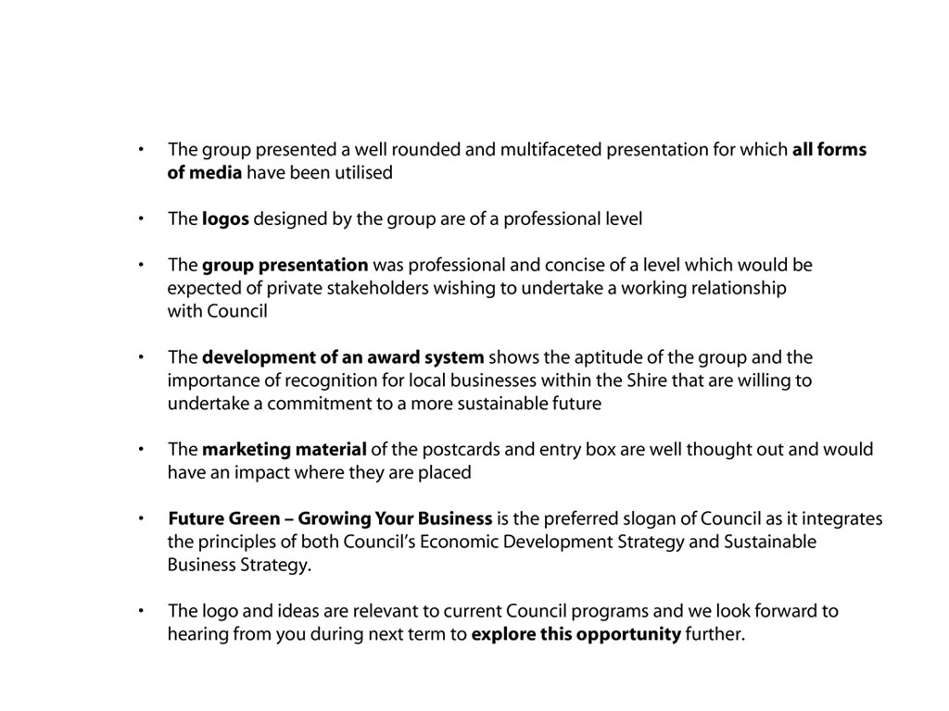
“
“
Notes:
Feedback

Slide 11
Notes:
Purpose:
to create an on-campus industry environment for
students to gain a more authentically professional experience;
to respond to customer needs and forge links with industry;
to enable students to apply a range of skills, across subject demarcations to actual projects;
to promote and utilise the design department and its resources more broadly within NSI.

Slide 12
Purpose:
to create an on-campus industry environment for
students to gain a more authentically professional experience;
to respond to customer needs and forge links with industry;
to enable students to apply a range of skills, across subject demarcations to actual projects;
to promote and utilise the design department and its resources more broadly within NSI.
Notes:
Purpose:
to create an on-campus industry environment for
students to gain a more authentically professional experience;
to respond to customer needs and forge links with industry;
to enable students to apply a range of skills, across subject demarcations to actual projects;
to promote and utilise the design department and its resources more broadly within NSI.

Slide 13
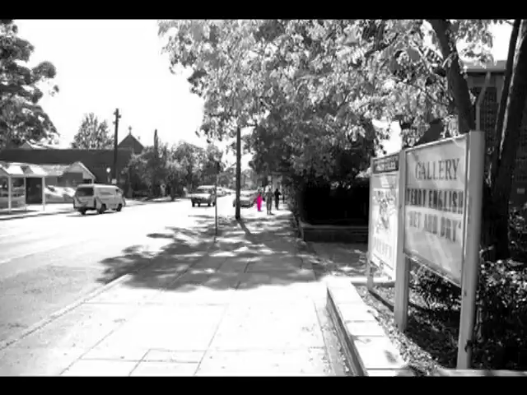

Slide 14

Notes:
Selection of projects undertaken in the White Room by students.
Shows designs for in-house (studio, section), the College and Institute, and local organisations

Slide 15
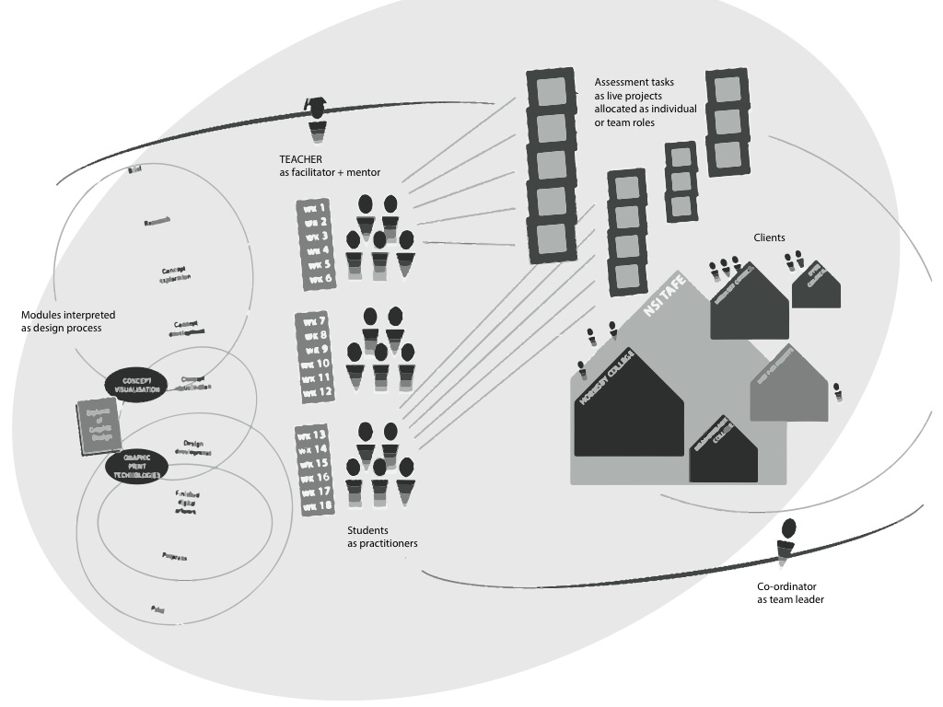
Notes:
Studio delivery and assessment schedule

Slide 16
Notes:
This table shows the distinction between classroom and studio in terms of delivery and assessment

Slide 17
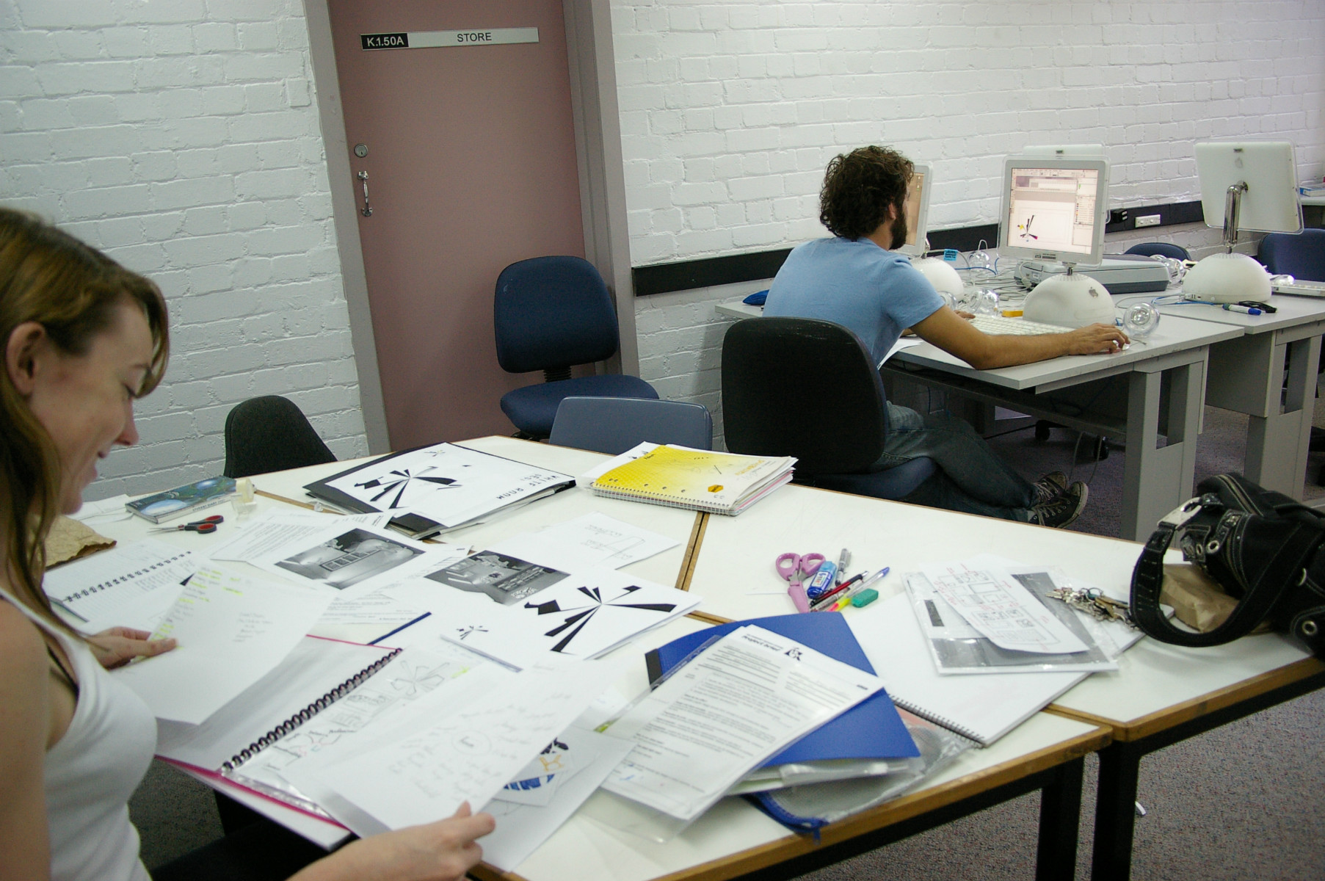

Slide 18
“You have to deal with clients and we need that.”
“The work is actually going to be used for something.”
“Briefs are more like industry briefs and have realistic deadlines.”
“We like a full day to get into the swing of things.”
Notes:
Student feedback

Slide 19
Purpose:
to improve sustainable work practices in the community;
to fulfill the organisational requirements of stakeholders;
to develop an online course with commercial potential for Northern Sydney Institute.
Notes:
Purpose:
to improve sustainable work practices in the community;
to collaborate in partnership with associated organisations;
to fulfill the organisational requirements for stakeholders;
to develop an online course with commercial potential for Northern Sydney Institute.

Slide 20
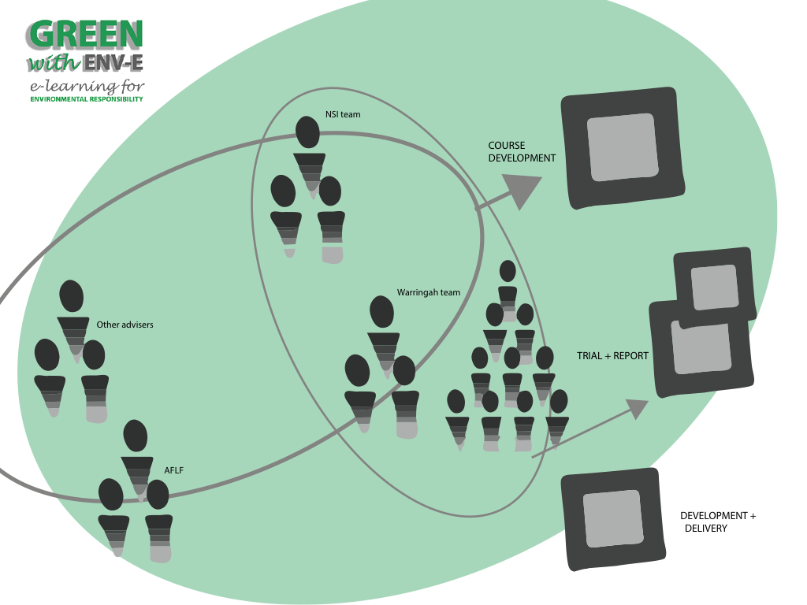

Slide 21
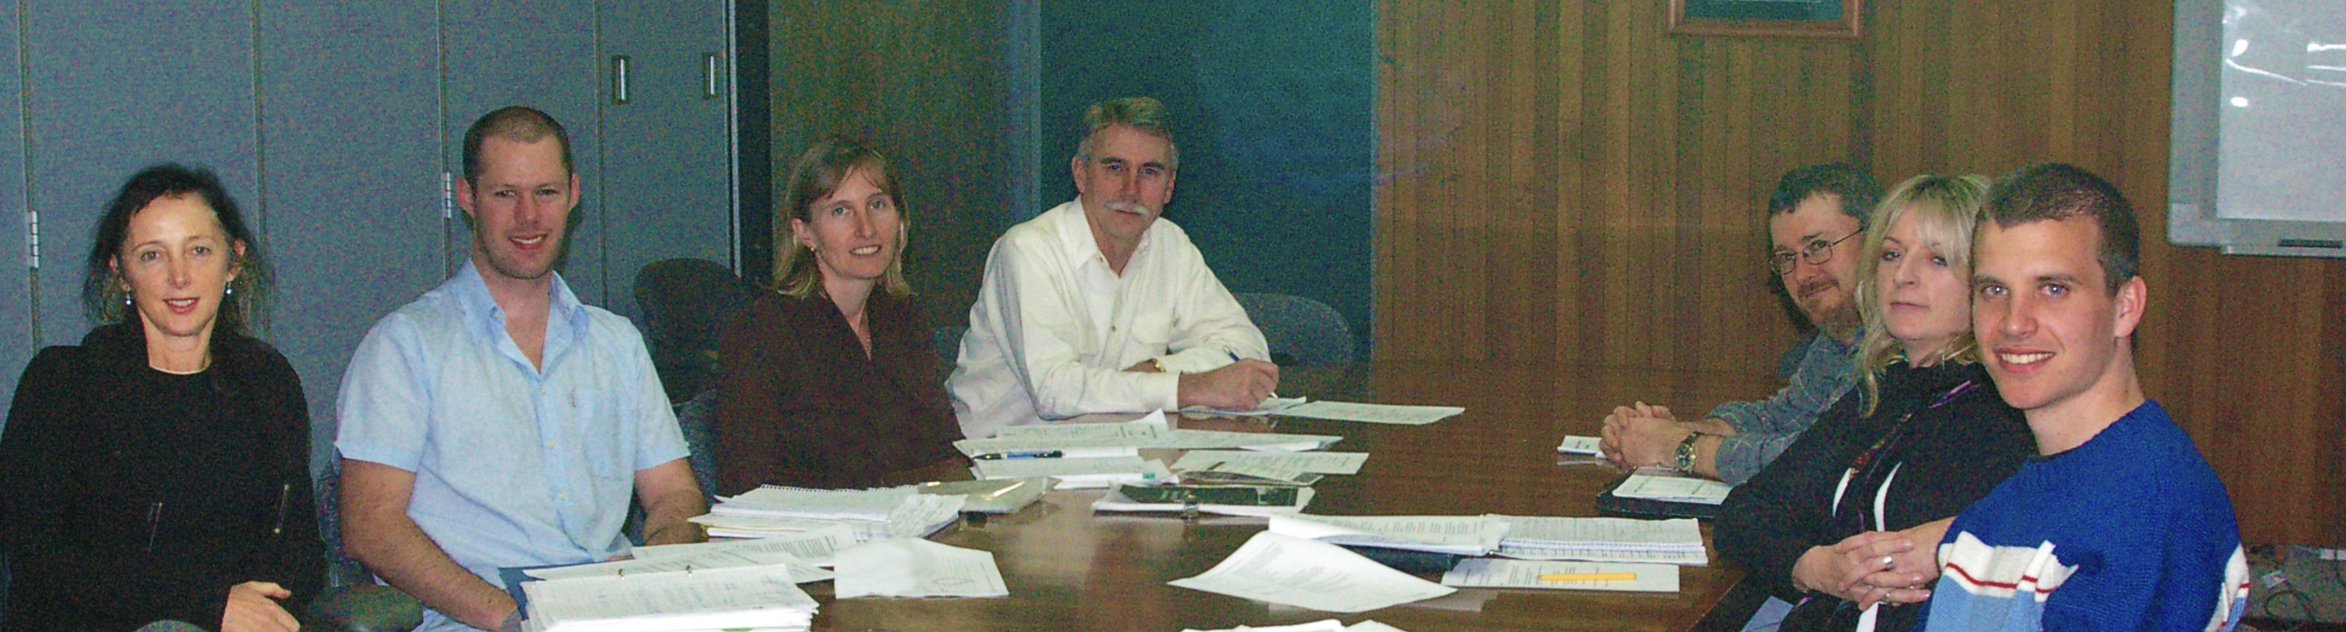
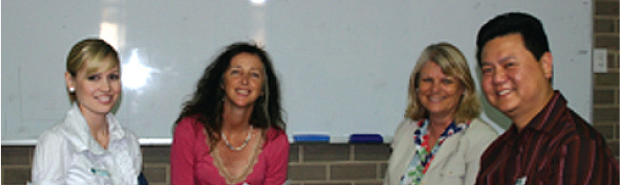
Notes:
The Warringah Council team and
The NSI team.

Slide 23

Notes:
Environmental planning and assessment act

Slide 24
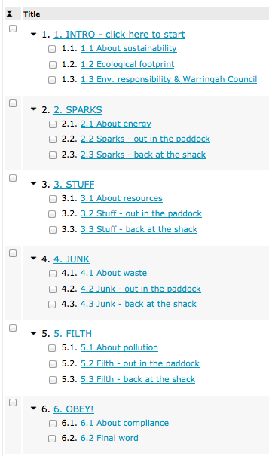

Slide 25
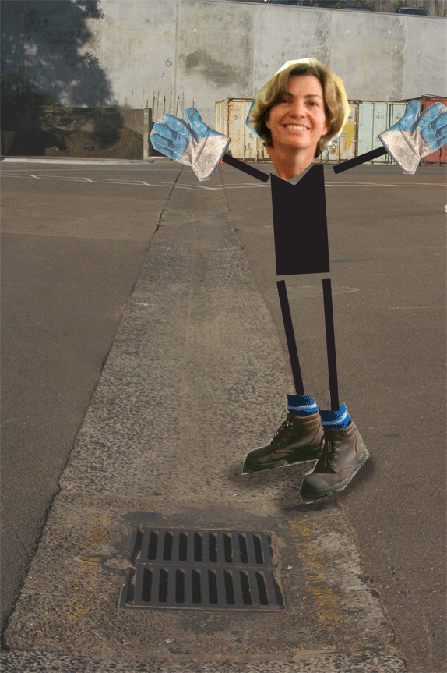
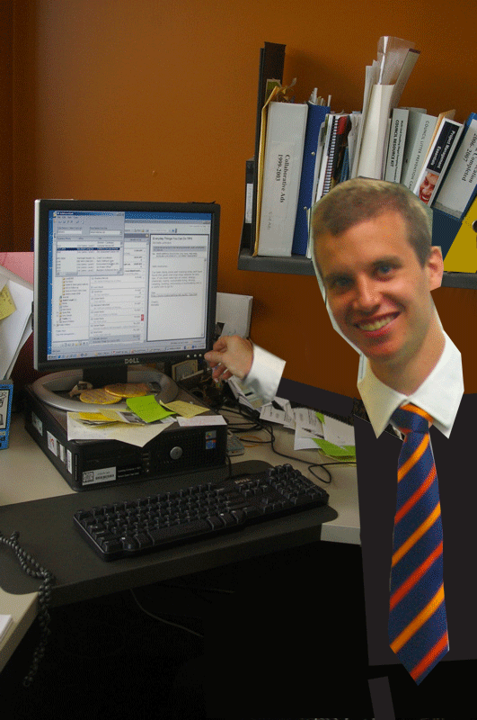
Out in the paddock
Back at the shack

Slide 26


Slide 27
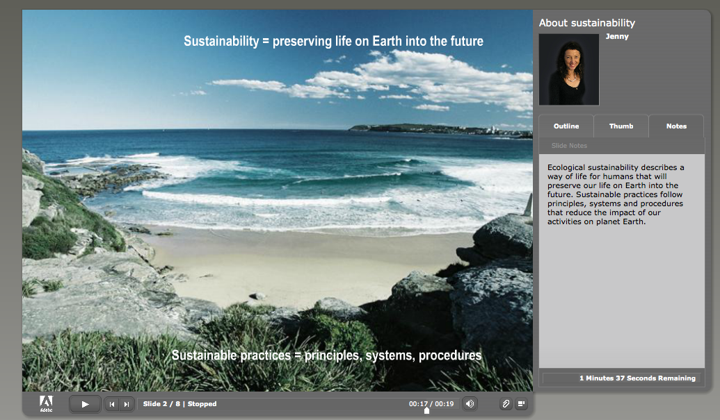


Slide 28
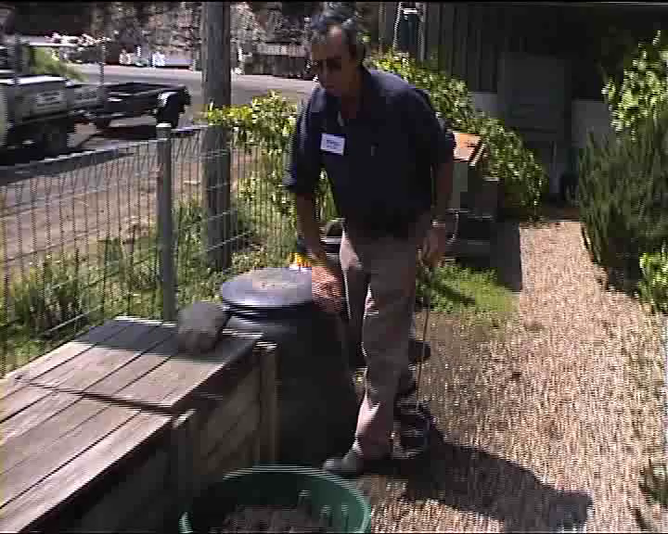

Slide 29
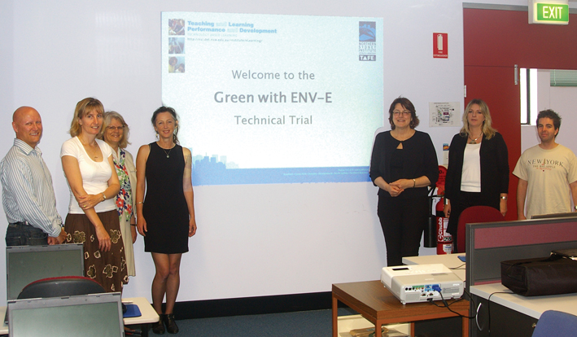

Slide 30

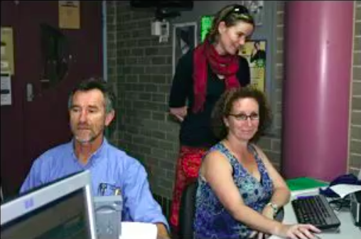

Slide 31
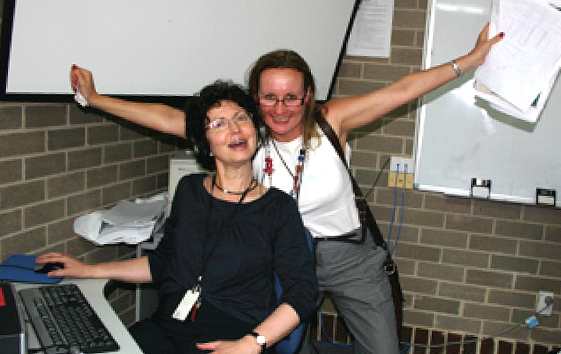
Notes:
Happy students just completed their course.

Slide 32
thanks!

