Slide 1
ADOBE CONNECT

Slide 2

Why did we use Adobe Connect?
We wanted to bring a great product to another location

Slide 3
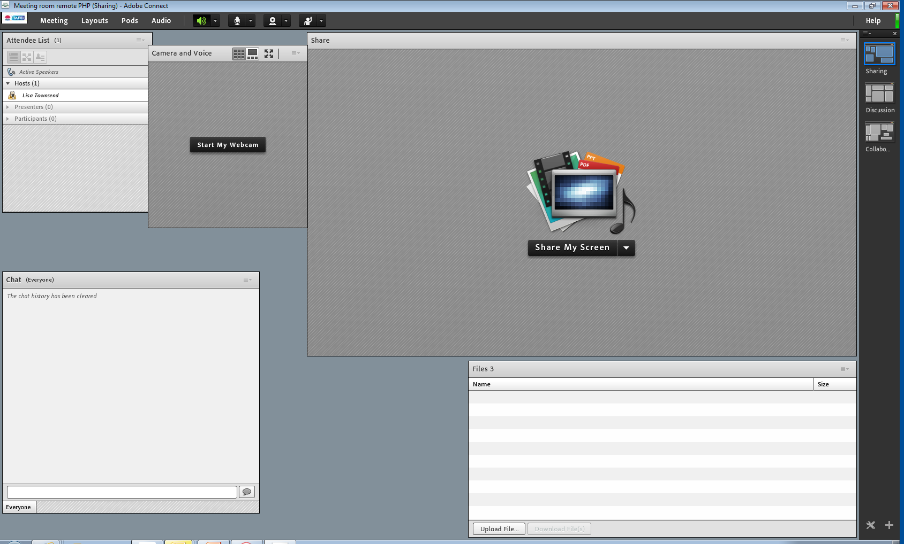
How did we set it up?
We sent an email to students:
Click here: https://webconf.det.nsw.edu.au/php

Slide 4
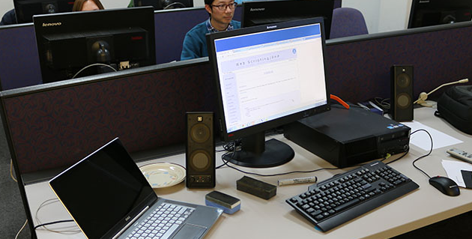
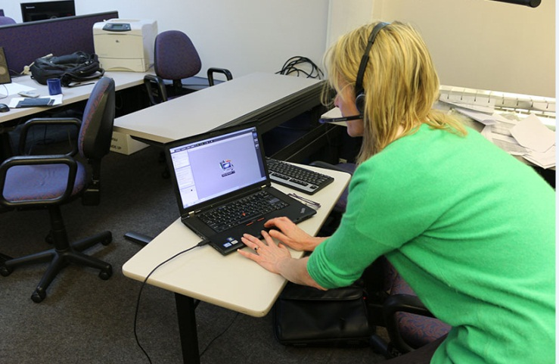
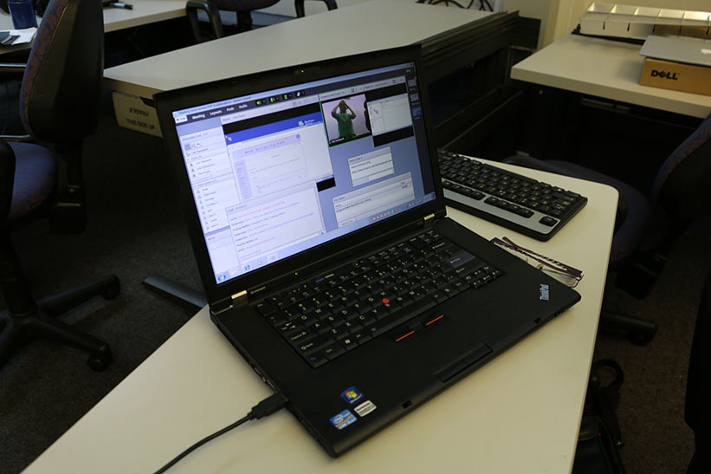
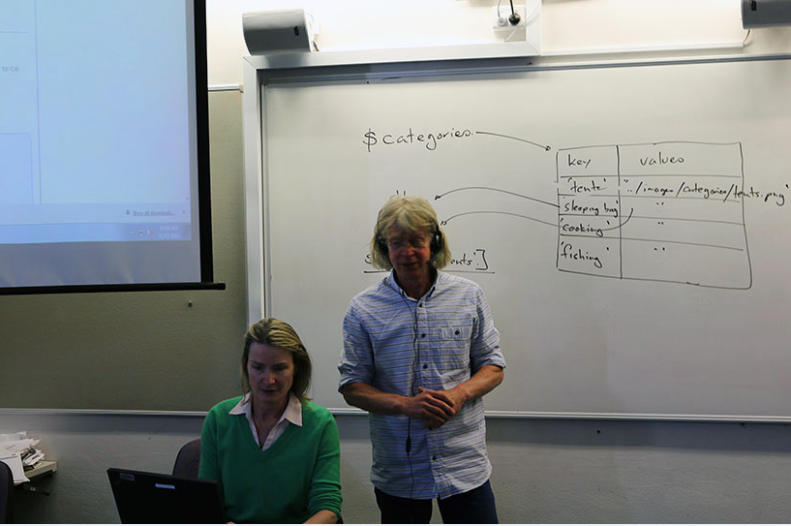
Setting up Adobe..
Set a laptop up in front of the class..

Slide 5
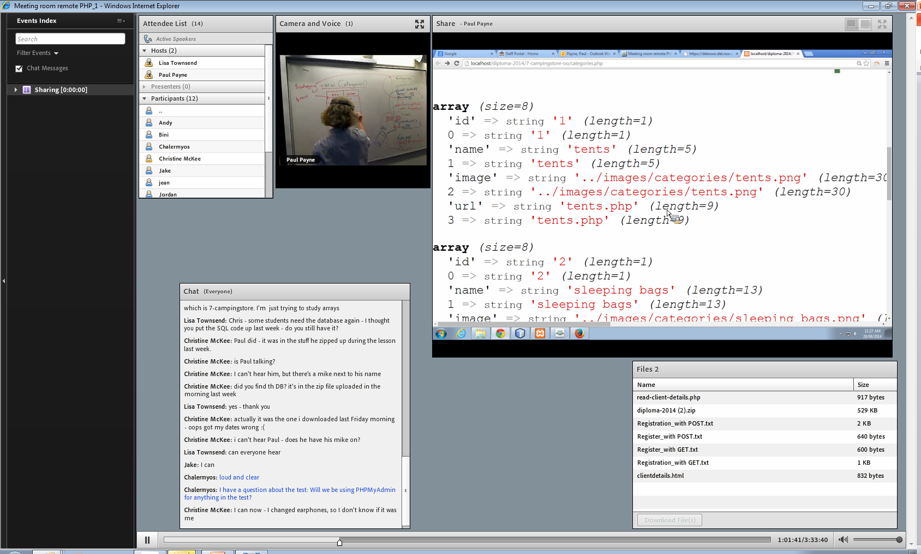
… and our students were there

Slide 6
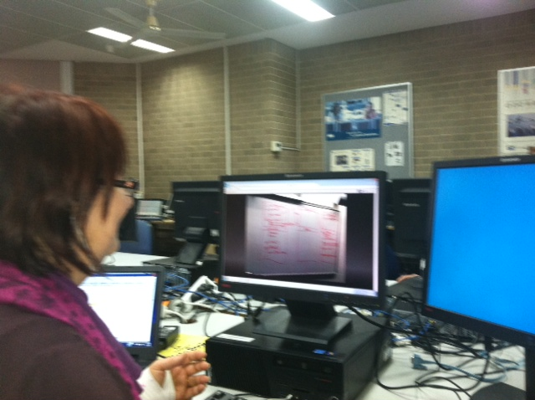
A facilitator helped our students so delivery wasn’t compromised

Slide 7
..and classes were recorded
https://webconf.det.nsw.edu.au/p9az3raz015/
..but we encouraged our students to attend in real-time
https://webconf.det.nsw.edu.au/php/

Slide 8
Advantages:
Students have all the advantages of face-to-face learning without having to travel.
Upskilling of other teachers.
Contingency.
Scalability.
Instant on-line material.

