Slide 1
NOT Myriad PRO

Slide 2
Notes:
My Psylosophy, and conveying that to the students A sign on the screen
My presentation is obviously from a humanist perspective of teaching Graphic Design
My YES / No cufflinks

Slide 3
Notes:
You have to gain the students respect, this comes from knowing your stuff and having a sound corporate experience

Slide 4
Notes:
Approach to students – Fairness, consistency, critical not mean, balance always present a happy demeanor. Students read and respond off your vibe

Slide 5
Notes:
The greatest gift you can give a student is the ability to be critical and fight for his/her own concepts and to challenge your views on their work
I always ask “WHY”

Slide 6
Notes:
Student from Central Coast not going to the city because Yukuza are lurking in alleyways ready to rob ad bash you up.
Also New York experience at Parsons School
Students to gain a frame of reference – Manet to Jelna

Slide 7
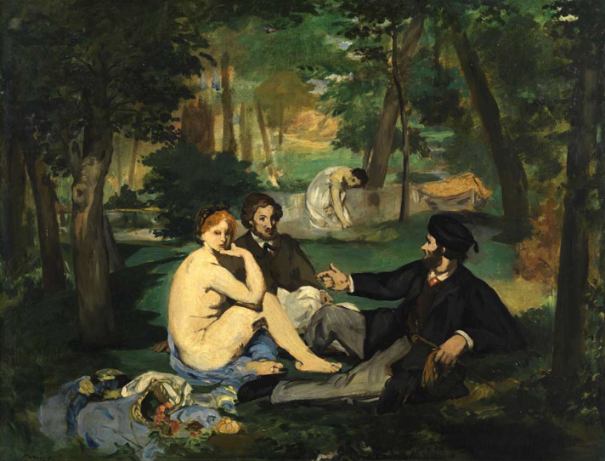
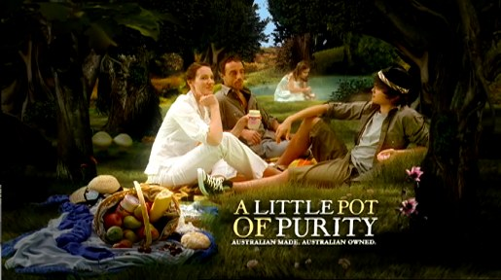
Jalna Yoghurt TVC endframe
Edouard Manet
Le Dejeuner sur l’herbe
The luncheon on the grass
“Le Bain”
Notes:
Building a frame of reference – looking outward – understanding how the future is informed by the past
Art directors discussing this concept
Take-away company using Leonardo De Vinci’s the Last Supper

Slide 8
Notes:
Just want to spotlight a couple of instances where finding the good in students pays dividends

Slide 9
Notes:
Boxing stuff and gradually getting him to create a broader range of work

Slide 10
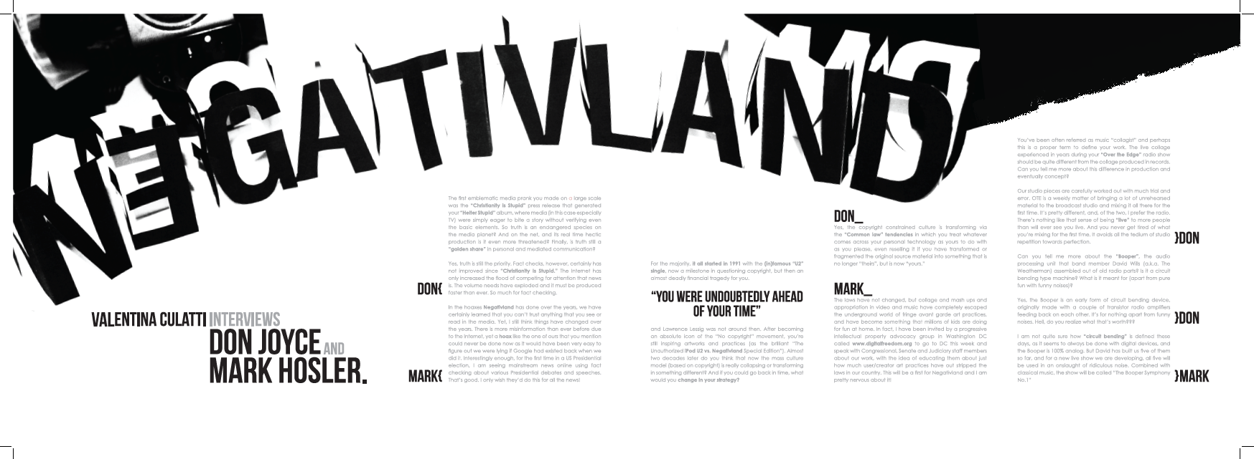
Notes:
Oliver’s negativland images

Slide 11
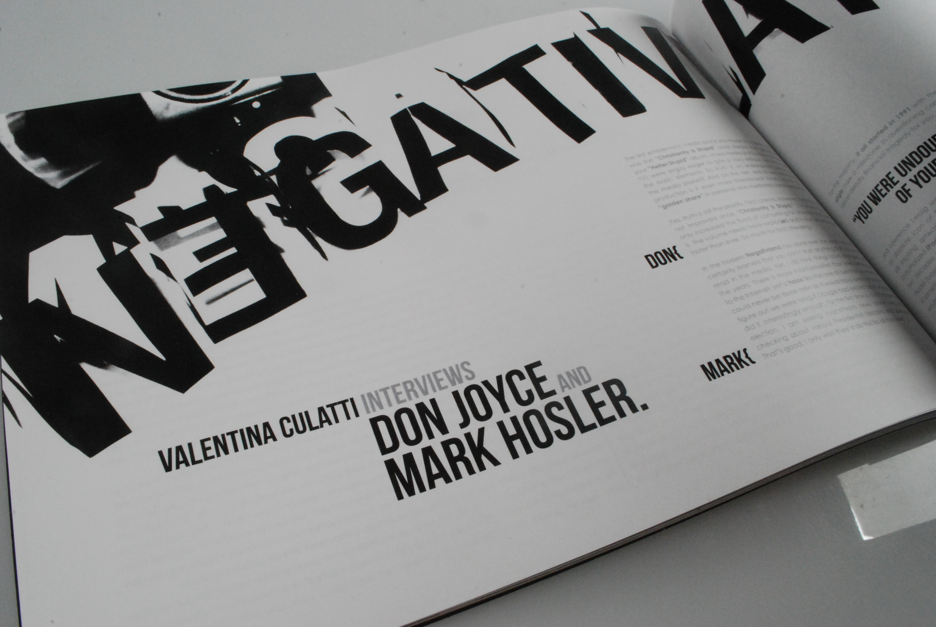
Notes:
Negativland image 2

Slide 12
Notes:
I don’t have any work to show but it is an interesting example of how you can get through to a student

Slide 13
Notes:
All about striving for excellence

Slide 14
Notes:
AC/NC Our students are competitive and constantly ask what their mark would be. I use the brain surgery analogy There is no one size fits all A mind set can set in
Author Jeanette Winterson (why be happy when you can be normal, and Oranges are not the only fruit) said The only things really worth trying are the things you think are impossible
Would Isaac Newton have bothered to discover the law of gravity if he only needed 50.1% or Steve Jobs creating his Apple empire. First Apple logo

Slide 15
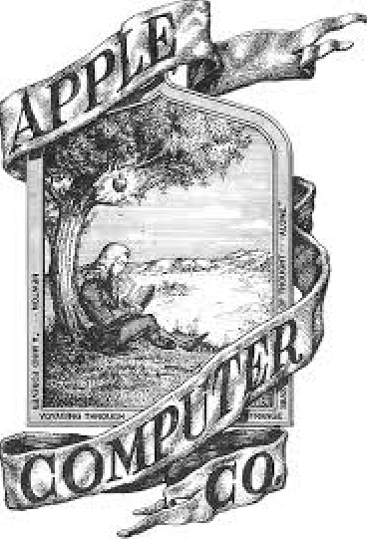
Notes:
1975 first Apple logo
I wonder if Steve Jobs ever realised how his company would impact on our lives

Slide 16
Notes:
Todd Sampson CEO of Leo Burnett and Gruen panelist was interviewed on “one + One” talking about his education. QUOTE Everybody will have one teacher that inspires them in their life.
I would like that teacher to be a TAFE teacher!!
I had a TAFE teacher who inspired me to get where I am today.

